Slide 1
PRODUCTIVITY AND EFFICIENCY ANALYSIS OF DISTRIBUTION UTILITIES
PROJECT GUIDE: GROUP MEMBERS
V. RAMAIAH T.VARUN GOPI (B16EE034)
Prof. EEE DEPT. B.MANIKANTA (B16EE028)
SD.AZAM (B16EE019)
K.SAI KIRAN(B16EE017)

Slide 2
Abstract
Indian electricity sector consists of highly sophisticated modern generation and transmission system, but a very poor distribution system in several utilities. Electricity sector regulators are practicing benchmarking of distribution companies to regulate the allowed revenue.
Mainly this is carried out based on the relative efficiency scores produced by frontier benchmarking techniques.
There are various techniques to find targets and benchmarking through performance evaluation.
A method for benchmarking performance of electric distribution utilities based on data envelopment analysis (DEA) is presented.
Basic theory of DEA is followed by evaluating the relative efficiencies and benchmarking of 55 electricity distribution utilities operating in different states in India.

Slide 3
Efficiency Approaches
Financial statement analysis
i. It includes ratios, staff productivity, asset quality etc.
ii. It is very complicated and unclear to the user as ratio of each and every quantity is undesired.
Frontier analysis
i. Mathematical programing (linear programming).
ii. Econometric approach (non linear programming).

Slide 4
Frontier analysis
DEA:
It is a popular management tool. Uses mathematical modeling.
i. A linear programming model is used to measure parameters like technical efficiency, scale efficiency, returns to scale etc.
ii. Measures how efficiently a DMU uses its resources to generate outputs.
iii. It can calculate the efficiency even in case of multiple inputs and multiple outputs.
iv. Based on benchmarking a units performance is compared with reference units.
v. Powerful tool to estimate the efficiencies.

Slide 5
Objectives
Evaluation of performance of distribution utilities and measurement of technical efficiency.
Comparison of DMU’s using data envelopment analysis
To identify the underlying causes of the inadequate sector performances.
Outcomes
Measurement of productivity and efficiency.
Benchmark the efficient DMU from the efficiency frontier obtained from DEA.
Identification of inefficient distribution companies.

Slide 6
Roles and responsibilities of the user
Have clear idea about which model to be selected according to his requirement.
Have an clear idea about what are his input and output parameters and collect accurate data as the DEA is very sensitive to input and output parameters.
Have to reduce the amount of input used or have to increase the amount of output by the information provided by DEA to reach the benchmark or target DMU.

Slide 7
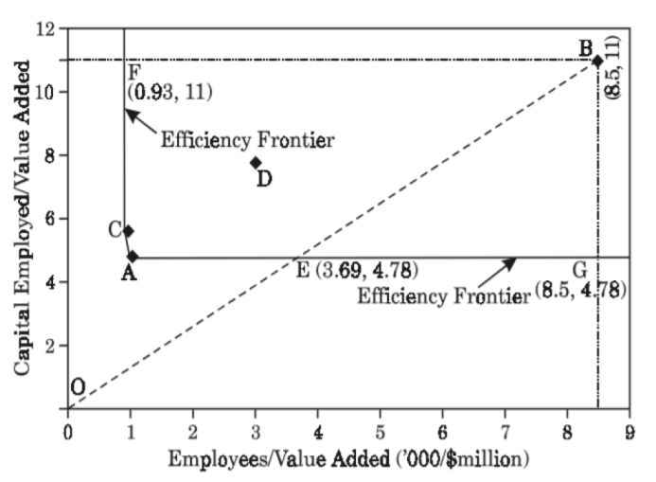
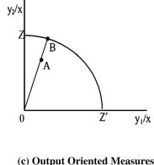
Input and output orientation
Input oriented:
In this type of orientation the output is kept constant and the input is reduced to improve the efficiency. Deals with minimization of inputs.
Output oriented:
In this type of orientation the input is kept constant and the output is increased to improve the efficiency. Deals with maximization of outputs.
input oriented

Slide 8
Types of models
CCR
BCC
Malmquist productivity index

Slide 9
CCR model
This is the basic model given by Carnes Cooper and Rhodes.
CCR gives us the information about technical efficiency. It used only when the technical efficiency information is alone desired.
CCR model assumes constant returns to scale. It can be used when there is not much variation between inputs and outputs.
CCR model can be used as
i. input oriented
ii. Output oriented
The type of orientation can be selected depending on DMU’s
In CCR model as constant returns to scale is assumed, the input oriented model gives the same results as the output oriented model.

Slide 10
BCC model
BCC model is advancement to CCR model.
It was proposed by Banker, Charnes and Cooper.
BCC model gives the information regarding technical efficiency, scale efficiency, and returns to scale.
Solved by linear programming method.
The BCC model is obtained by adding summation of lambdas to CCR model
The summation of lambdas refer to returns to scale.
BCC model can be selected when the information about scale efficiency and returns to scale is also needed.

Slide 11
Malmquist productivity index
Malmquist Productivity Index(MPI) measures the productivity changes along with time
Gives the changes in efficiency with the change in time using distance function.
The technical efficiency is different from change in efficiency.
One of the most important objection of this model is the mathematical complexity of it.

Slide 12

Malmquist productivity index is given by
E represents the efficiency change and
T represents technological change
D^{t} is the distance function measuring the efficiency of conversion of x^{t} inputs to y^{t} outputs during the period t.
Note that if there is a technological change during the period (t + 1), then,
D^{t+1} (x^{t},y^{t}) = Efficiency of conversion of input at period t to output at period t.

Slide 13
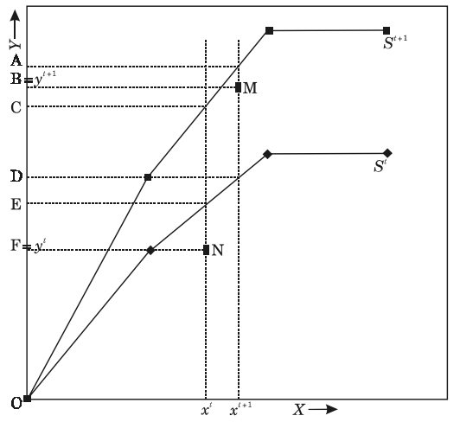
M represents achievement at time (t + 1), while N represents the achievement at time t.

Slide 14
Advantages of Malmquist over BCC and CCR
The socio-economic growth and change in significance of companies over years can be found.
Efficiency is calculated for N years using Malmquist method.
Consumes less time and space.
Can be easily evaluated by the companies as it is simple.
Comparison with their own self over years.

Slide 15
DEAP Software
The software used for evaluating the performance of Distribution Utilities is DEAP. DEAP is the method which gives the evaluation results which is easily adoptable by the user.
It consists of three files. They are:
Data file
Instruction file
Output file

Slide 16
Data File
The data must be listed by observation (i.e., one row for each firm).
There must be a column for each output and each input, with all outputs listed first and then all inputs listed (from left to right across the file).
The data used for this project are given above of 55 DISCOMS of India in tables 1 and 2 and the data considered is named as firm 1, firm2, firm3, firm 4 and so on… firm 55 for DISCOMS NBPDCL, SBPDCL, JBVNL, CESU, NESCO, SESCO………., MSEDCL a total of 55 firms respectively.
The inputs and outputs of our project are taken from 55 DISCOMS as listed in the table for the years of 2014 to 2016.

Slide 17
Data and Variables
Generally the inputs selected should represent resources used which in case of distribution utilities are
Total Expenditure (crores)
Power Purchased , Employee Cost
Operation & Maintenance Cost, Interest Cost
Depreciation, Administrative & General Expenses
AT&C Losses (%)
The outputs represent the levels of utility which in this case are
Energy Sold (Mkwh)
Collection efficiency (%)

Slide 18
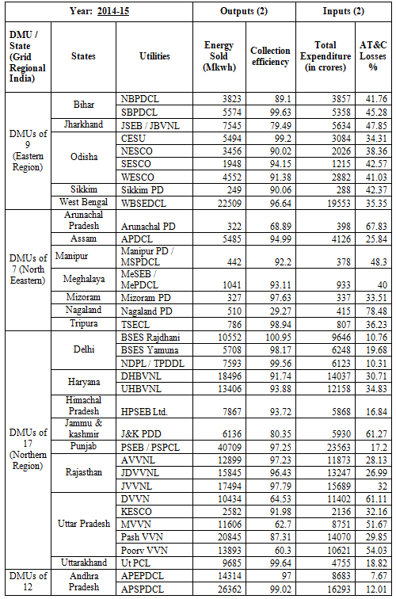

Slide 19
Instruction File
Create an instruction file giving further details of the computation.
The instruction file contains nine lines and provide necessary information on the
names of data and output files,
number of firms,
number of time periods,
number of inputs and outputs,
input or output, orientation,
CRS or VRS,
Model selection
For Malmquist model is independent of return to scale type.

Slide 20
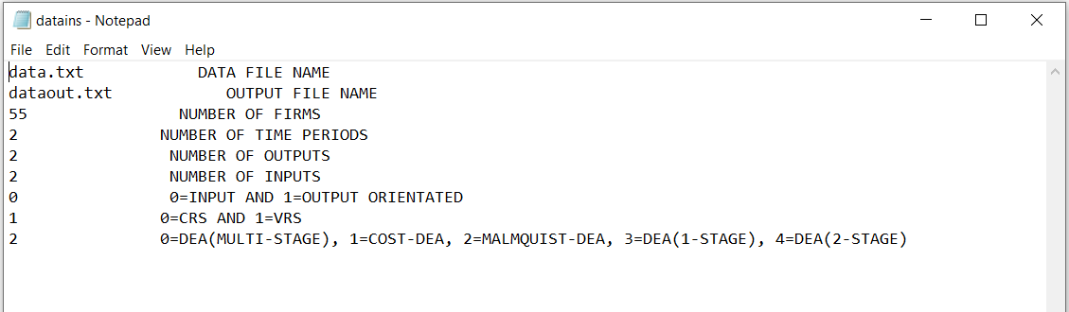
Malmquist index uses input oriented model
To select malmquist index load with 2.

Slide 21
Output File
DEA calculations can be performed by invoking the executable file DEAP.EXE.
Once invoked, the software will prompt for the name of instruction file.
The name of the instruction file should then be supplied on the screen (along with the .INS extension).
DEAP will then take some time to make the DEA computations, and will create the output file (with the name as specified in the instruction file).
The output is self-explanatory.
The output will be saved in form of text.
All the indices are related to previous year. Hence the output begins with year 2.

Slide 22
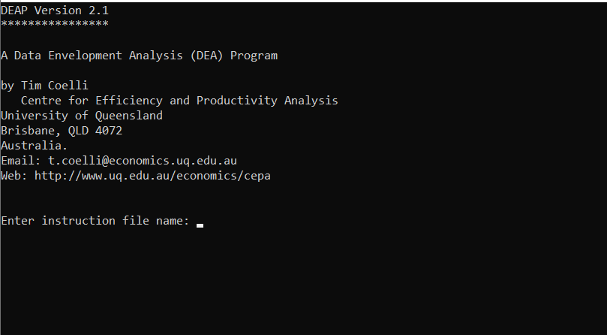
After loading the instruction file the DEAP is executed by loading the name of instruction file

Slide 23
TERMS TO BE UNDERSTOOD
Efficiency change (effch):
Gives the change in efficiency of a firm with time series
Technological change (techch):
Gives the factor with which the technology of converting inputs to outputs have changed.
Scale efficiency change (sech):
Scale efficiency change gives the change in the revenue or finance with the improvement or change in technology.
Total factor of production change (tfpch):
Gives the total factor of change of production of a firm over years.

Slide 24
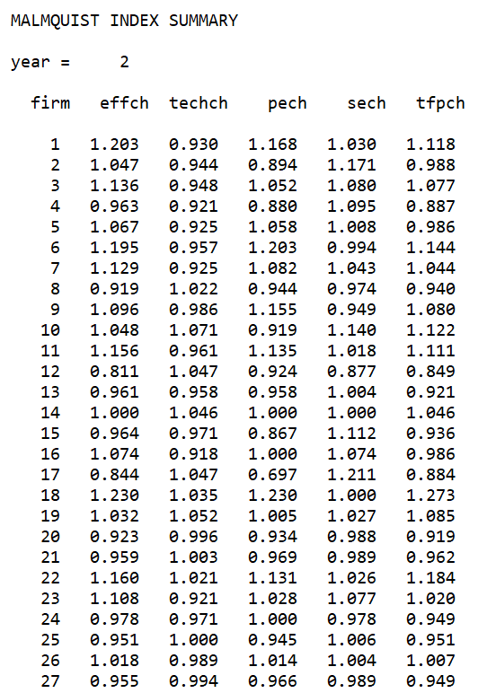

Slide 25
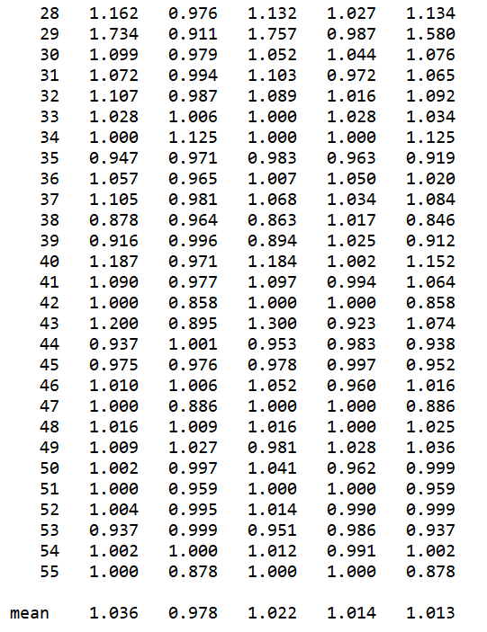

Slide 26
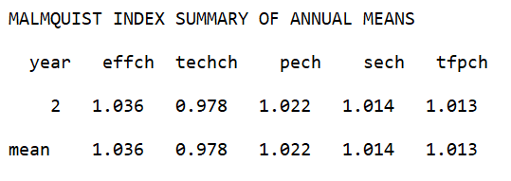
The summary of annual means
Output file provides the estimates of the Malmquist total factor productivity and its components.
The analysis reveals that, on an average Malmquist productivity or total factor productivity increased by 1.3 percent during 2015 to 2016.

Slide 27
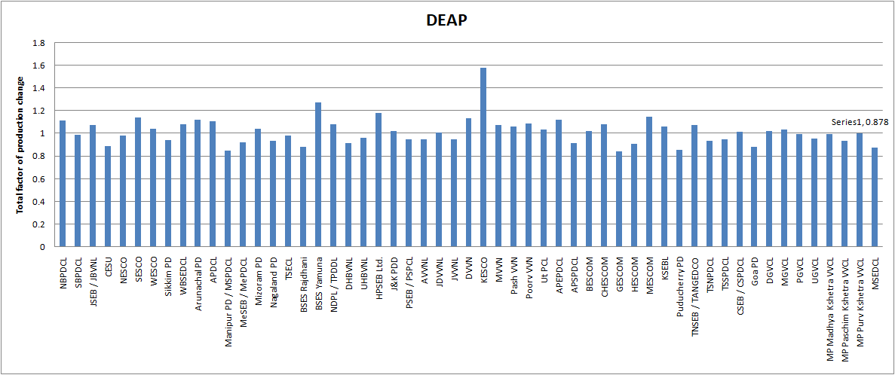
Results

Slide 28
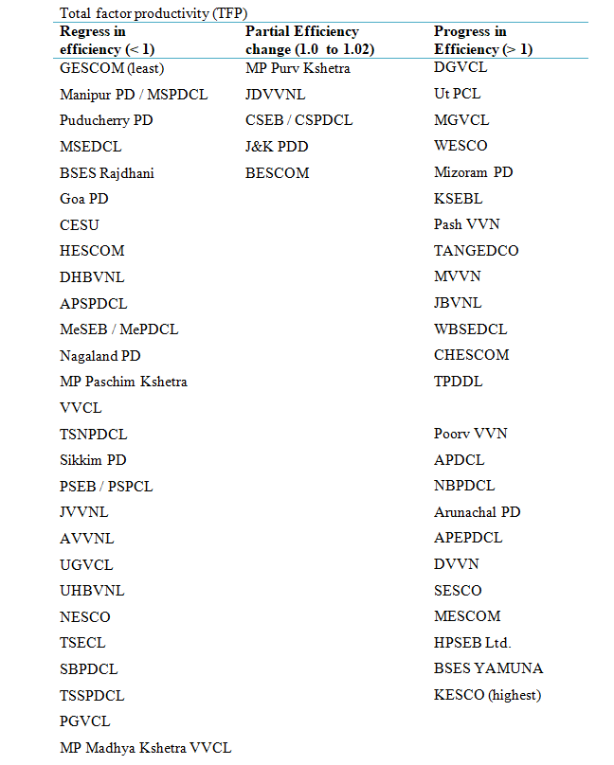

Slide 29
Conclusion
The total factor productivity change of the DISCOMS using a balanced panel data set of 110 observations for 55 DISCOMS over the period of 2014-2016.
The analysis reveals that, on an average Malmquist productivity or total factor productivity increased by 1.3 percent during 2015-2016. This suggests that DMUs have experienced or achieved moderate productivity growth during the period.
Though many of the DMUs (24 out of 55 DMUs) have shown improvement in technological change, the DISCOMS as a whole has exhibited a decline in technological change (15.4% percent decrease over the period) and suggested that there has been deterioration in the performance of the DMUs.

Slide 30
Reference
Banker, R.D., Charnes, A. and Cooper, W.W. (1984) ‘Some models for estimating technical and scale inefficiencies in data envelopment analysis’, Management Science, Vol. 30, No. 9, pp.1078–1092.
Charnes, A., Clark, T., Cooper, W.W. and Golany, B. (1985) ‘A development study of data envelopment analysis in measuring the efficiency of maintenance units in the US Air Force’, Annals of Operations Research, Vol. 2, No. 1, pp.95–112.
Charnes, A., Cooper, W.W. and Rhodes, E. (1978) ‘Measuring the efficiency of decision making units’, European Journal of Operational Research, Vol. 2, No. 6, pp.429–444.
Cooper, W.W., Seiford, L.M. and Tone, K. (2000) Data Envelopment Analysis: A Comprehensive Text with Models, Applications, Reference and DEA-Solver Software, Kulwer Academic Publishers, Boston.

Slide 31
THANKYOU

